Slide 1
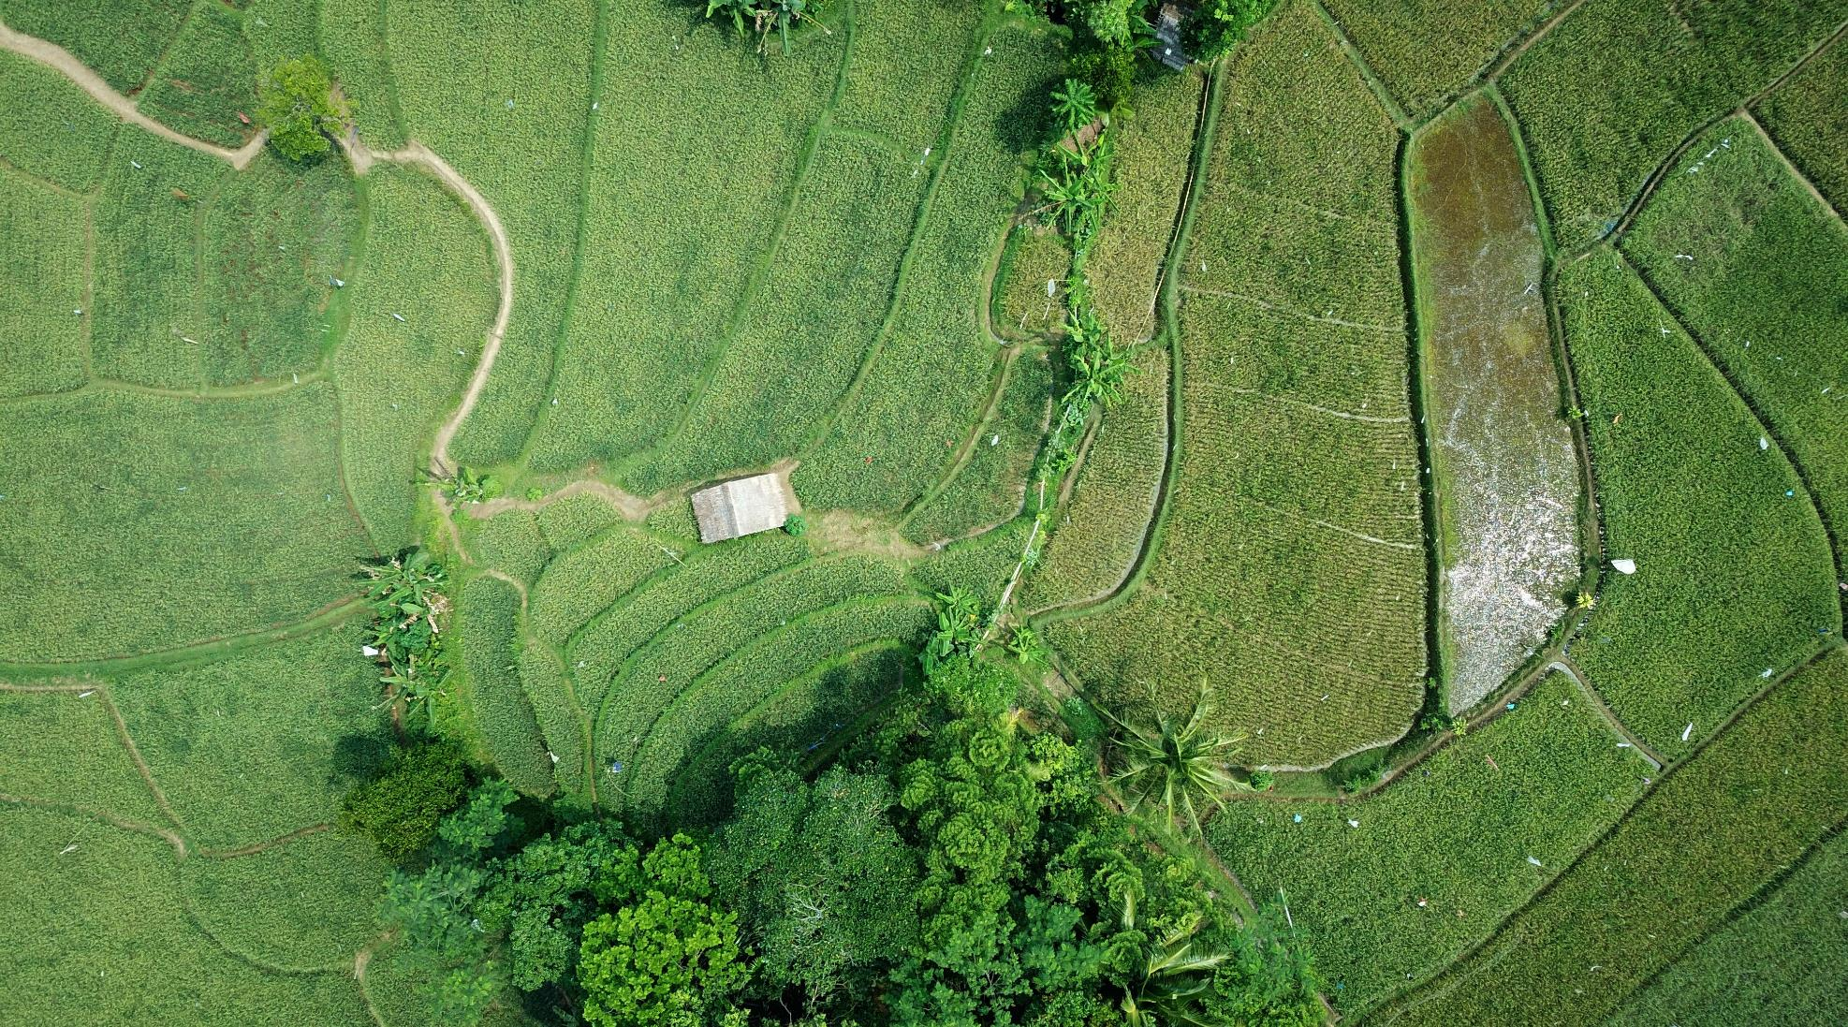

Walchand College Of Engineering, Sangli (An Autonomous Institute) Mini-Project on SMART IRRIGATION SYSTEM USING IOT
Anmol Bhat (2018BTECS00020)
Manay Kumar Sharma (2018BTECS00013)
Mohit Kumar (2018BTECS00030) Under the Guidance of
- Prof. A.R Surve

Slide 2
Problem Statement
According to the UN projections, world population will rise from 6.8 billion today to 9.1 billion in 2050 that signifies food production has to be raised to feed the one third more mouths. And, the agriculture industry is accountable for fulfilling humans’ need for food, energy, and shelter to a great extent.
The only solution to all these problems is Agriculture. For the next generation agriculture fields, data collected from sensors would become the fertilizer to grow crops. It’s really perplexing, but true. IOT would uncover the new ways that tap the full potential of agriculture yield and alleviate all the challenges that hinders the growth of the crop.

Slide 3
Objective
To save water and reduce human intervention in the agriculture field.
Continuously monitoring the status of soil through sensors and provide signal for taking necessary action.
To get the output of the sensors and provide water to crop.
To observe parameters for better yield.

Slide 4
Outcomes
Soil moisture sensors and temperature sensors, which are placed on the field will send real time data to the micro controller.
Smart irrigation system will make it possible for growers to monitor and irrigate their fields remotely, without any hassles.
It might help in reducing wastage of water.

Slide 5

Customers
Farmers who have large acres of land to irrigate.
Busy schedule persons who generally doesn't look after their gardens and plants.
Persons in area where there is scarcity of water specially in desert areas.
Families for well nourished and all maintained caring of their plants and pots.

Slide 6
Market Potential
Rising importance for efficient irrigation solutions and watering practices is the key factor drives the growth of global smart irrigation market. Smart irrigation system is an automated system, provides plants the exact water when it’s required without any manual intervention. Smart irrigation system automatically adjust the watering schedule based various real-time parameters including water content of the plant, wind speed, wind direction and local weather data. Smart irrigation practice delivers various advantage, including environmental sustainability, reduced labor cost, and also lowers the expense of water usage.
Global Smart Irrigation Market: Market Dynamics
Increasing government initiatives to promote water conservation, expanding farming operations cost and growing importance to increase farm profit by utilizing automated irrigation solutions are the primary factors drives the growth of global smart irrigation market. Additionally, increasing research and development investment for developing reliable irrigation scheduling solutions, growing interest on developing smart irrigation solutions using internet of things (IoT) and continuous advancement in sensing and monitoring technologies, accelerates the growth of global smart irrigation market. Also, increasing need to monitor and control the water requirements of the field due to inadequate rainfall and water scarcity across the world, further expected to fuel the growth of global smart irrigation market.
Global Smart Irrigation Market: Market Segmentation
The global smart irrigation market is segmented on the basis of component, technology, application and by region. On the basis of component, the global smart irrigation market is segmented into hardware and software, the hardware sub-segment can be further segmented into sensors, controllers, sprinkler nozzles and others. On the basis of technology, the global smart irrigation market is segmented into evapotranspiration based smart irrigation technology and soil moisture based smart irrigation technology. On the basis of application, the global smart irrigation market is segmented into agriculture and non-agriculture. Regionally, the global smart irrigation market is segmented into North America, Latin America, Western Europe, Eastern Europe, Middle East & Africa (MEA), Asia Pacific excluding Japan (APEJ) and Japan.

Slide 7

Technology Stack
Arduino
Arduino programming language
Some other physical components

Slide 8
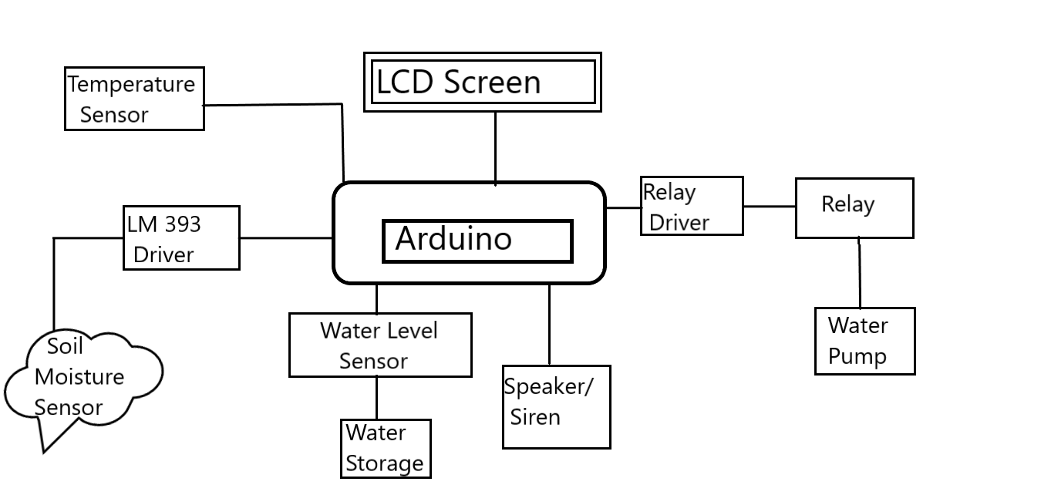
UML Diagram

Slide 9
Project Plan
We will be following nimble methodology for our project. We will complete below listed task in different phases and in each phase we will be doing Planning, Requirements Analysis, Design, Coding and Testing.
Collecting all the data from various resources and then remerging it in a well-organized way.
Testing the data and resources in an organized and well-mannered way.
Designing the code for the working of the ADRUINO using suitable coding languages
After assuring proper coding, testing, maintenance and removing all errors offering the best suitable product to the users

Slide 10






Thank You
Team
+91 7006085491
manaysharma9977@gmail.com
www.github.com

Slide 11



Team
Anmol Bhat
Manay Kumar Sharma
Mohit Kumar
BOSS
BOSS
BOSS
ABCD
ABCD
ABCD

